Slide 1
CMSC 426 Principles of Computer Security
Introduction to Cryptology

Slide 2
Last Class We Covered
Exam!!!
Hope to get them graded before next class
(No promises, though!)

Slide 3
Any Questions from Last Time?

Slide 4
Today’s Topics
Introduction to crypto
Ciphers
Block ciphers
DES
3DES
AES

Slide 5
Crypto Definitions

Slide 6
Crypto-
Cryptography
“Hidden writing”
Creation and use of secret codes and data-related security measures
Cryptanalysis
Theory and practice of “breaking” cryptographic protocols
“Breaking” means recovering protected text/bypassing security
Cryptology
The study of coded messages
Scientific study of codes: creating, using, analyzing, “breaking”

Slide 7
Encryption Types
Encryption
Turning plain text into encrypted, “protected” text
Decryption
Returning encrypted text to a readable, plain text state
Symmetric Encryption
Uses the same key for encryption and decryption
Asymmetric Encryption
Uses different keys for encryption and decryption

Slide 8
Symmetric Encryption

Slide 9
Components of Symmetric Encryption
Plaintext
Ciphertext
Encryption algorithm
Secret key
Decryption algorithm
Example: Vigenère cipher
“ATTACK AT DAWN” with “DOG” as the keyword
Ciphertext is “DHZDQQ DH JDKT”

Slide 10
Historical Ciphers (Algorithms)
Caesar cipher
“Rotation” of the alphabet
Atbash cipher
“Reversal” of the alphabet
Keyword cipher
Keyword “begins” the alphabet, rest follows in order
“Cryptography”: CRYPTOGAHBDEFIJKLMNQSUVWXZ
Vigenère cipher
Keyword is repeated, and is used to shift plaintext into ciphertext

Slide 11
Substitution Cipher Example
Assume an “alphabet” of 38 characters: A-Z, 0-9, “ ”, and .
The substitution cipher is random in this case – there is no keyword or simple reversal/shift of the alphabet
PX2LOB.1MWGSU0V5H6TYNF9K IA7QO3ZJRE4CD8
What is the plaintext, ciphertext, encryption algorithm, secret key, and decryption algorithm in this case?

Slide 12
Substitution Cipher Example
Plaintext
Ciphertext
Both are a message written in the 38-character alphabet
Encryption algorithm
Application of the substitution cipher to the original message
Secret Key
The substitution ciphered alphabet
Decryption algorithm
Application of the inverse of the substitution cipher

Slide 13
Block Ciphers (Symmetric Block Encryption)

Slide 14
Block Ciphers
Process the plaintext in fixed-size “blocks” (hence the name)
Ciphertext produced is of blocks of equal size
Block ciphers are symmetric algorithms
Key remains the same for encryption and decryption
However, two separate algorithms for en/decryption
Most commonly-used algorithms are DES, 3DES, and AES

Slide 15
Block Cipher Algorithms
Sequence of rounds, made of permutations and substitutions
Each round has its own unique subkey value, derived from the key
DES and 3DES both use a Feistel network structure
Basic encryption and decryption algorithm are the same
Only difference is the order in which subkeys are applied
16 rounds of en/decryption
Makes use of XOR and substitution

Slide 16
Components of Block Ciphers
Block size
Size in bits of a plaintext/ciphertext block (commonly 128 bits)
Key size
Size in bits of the key (commonly 128 bits)
Round function
Basic encryption function; iterated to form the encryption algorithm
Number of rounds
The number of iterations of the round function
Subkey algorithm
Algorithm that expands the key into multiple round keys

Slide 17
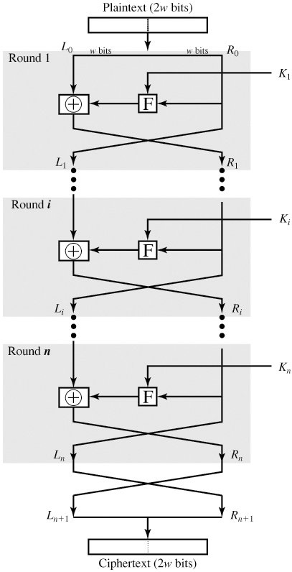
Feistel Networks
Iterative structure used in the DES and 3DES algorithms
Split 64 bits of input into right and left blocks
Apply Feistel function to the right half of the data
XOR it using the left half of the data
Swap the two blocks for the next round
Each of the 16 rounds is identical
(Which is why we swap the data’s sides)
Only difference is the subkey used in the Feistel function
Image taken from Computer Security (Stallings & Brown)

Slide 18
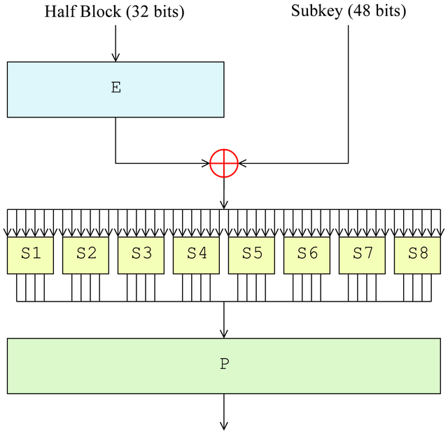
Feistel Function
Consists of four stages, done on 32 bits of data
Expansion: 32 bits is expanded to 48 bits (eight 6 bit pieces, which each contain a copy of the adjacent bit on each side)
Key mixing: XOR’d with 48-bit subkey
Substitution: divided into eight 6 bit pieces again, which are processed by the substitution boxes (S-box)
Turns 6 bits in 4 bits according to a non-linear transformation (provided by a lookup table)
Core component of the security of DES; without these, it would be trivial to break
Permutation: outputs are rearranged according to a fixed permutation, so that the same bits don’t go through the same substitution box again together
Image and information taken from https://en.wikipedia.org/wiki/Data_Encryption_Standard

Slide 19
DES (Data Encryption Standard)
Blocks are 64 bits
Key is 56 bits
Actually 64 bits, but every 8th bit is a parity bit
Algorithm itself is very secure
Very well-studied, and no reported fatal weaknesses
Key size is woefully small
Only 72,000,000,000,000,000 possible keys
Can be brute-forced by a powerful machine in about an hour
Adopted in 1977, but not used widely since the 90s

Slide 20
Triple DES (or 3DES)
Uses 3 keys, for a total key size of 168 bits
Either two or three independent keys, depending on implementation
To encrypt, it applies the original DES algorithm as follows:
Encrypt with key 1
Decrypt with key 2
Encrypt with key 3
(If only two keys used, duplicate is used as key 1 and key 3)
Three times as slow as DES… not good for large encryption jobs

Slide 21
AES (Advanced Encryption Standard)

Slide 22
Advanced Encryption Standard
AES is also a block cipher, but does not use Feistel networks
Instead of splitting data in half and using one half to modify the other, AES processes the entire data block in parallel
Block length is 128 bits, and key can be 128, 192, or 256 bits
For purposes of this class, we’ll assume the key is always 128 bits
With 128 bits, this means that AES performs 10 rounds
Decryption is still performed with keys applied in reverse
But encryption and decryption algorithms are not identical as in DES

Slide 23
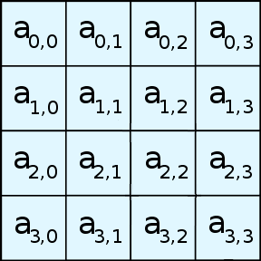
AES Algorithm Overview
128 bits of input are represented as a 4 by 4 array of bytes
Four different stages are performed in each round
Substitute Bytes
Shift Rows
Mix Columns
Add Round Key
substitution steps
Skipped in last round.
permutation step
Also occurs before the rounds begin.
Image and information taken from https://en.wikipedia.org/wiki/Advanced_Encryption_Standard

Slide 24
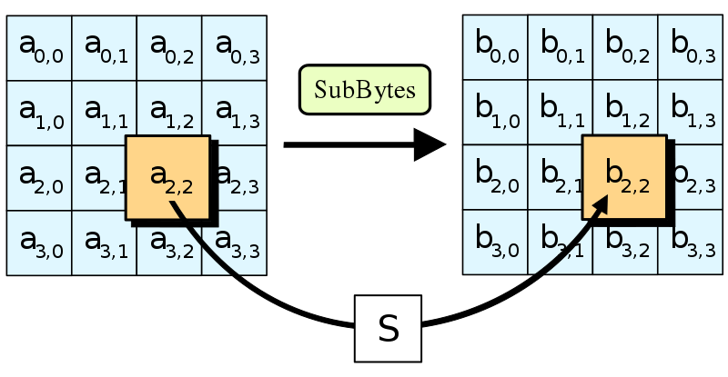
Substitute Bytes
Uses an S-box to perform a table lookup that allows for a byte-by-byte substitution of the block
Provides the non-linearity in the cipher
S-box is derived based on information from the key, using complex math we won’t cover in this class
(Multiplicative inverse, affine transformation, etc.)
When decrypting, this is the step that differs, creating a different, “inverse” S-box
Image and information taken from https://en.wikipedia.org/wiki/Advanced_Encryption_Standard

Slide 25
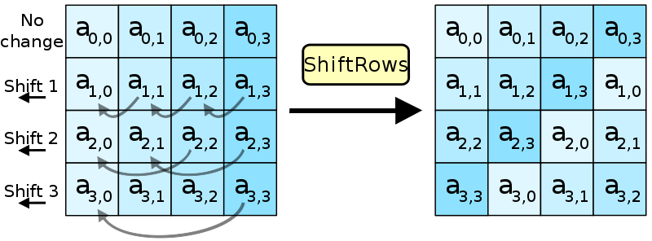
Shift Rows
Each row is shifted by an offset
This means that each column now contains information from each row
This prevents the columns in the 4 by 4 array from being encrypted together throughout all the rounds
Image and information taken from https://en.wikipedia.org/wiki/Advanced_Encryption_Standard

Slide 26
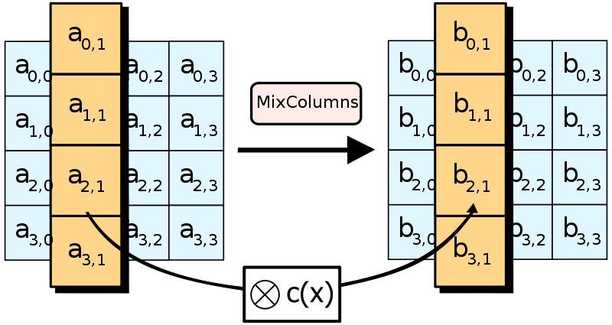
Mix Columns
Each column is altered, taking in the four bytes of the column, and outputting four bytes
Each input byte affects all four output bytes (more math)
This step does not occur in the final round of the algorithm
Image and information taken from https://en.wikipedia.org/wiki/Advanced_Encryption_Standard

Slide 27
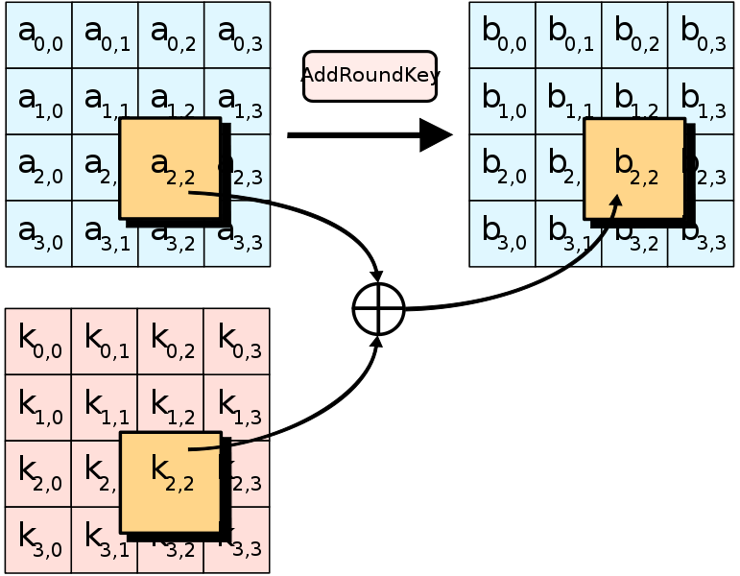
Add Round Key
Before the rounds begin, the original 128 bit key is expanded into an array of subkeys for each round
Simple bitwise XOR of the current block with that round’s subkey
This stage also occurs initially, before the rounds have properly begun
Image and information taken from https://en.wikipedia.org/wiki/Advanced_Encryption_Standard

Slide 28
Announcements
Paper 2&3 and Homework 2 will be released later today
Homework 2 will be due next Wednesday (17th)
Paper 2&3 will be due October 24th
Lab 2 is due next Wednesday (17th)

